Slide 1
Cassandra CQL Introduction
Penny Weng 翁瑞昕

Slide 2
Table of Contents
Keyspace-Level Functions
Table-Level Functions
Row-Level Functions
Select
Insert / Update
Delete / Batch
Data Types

Slide 3
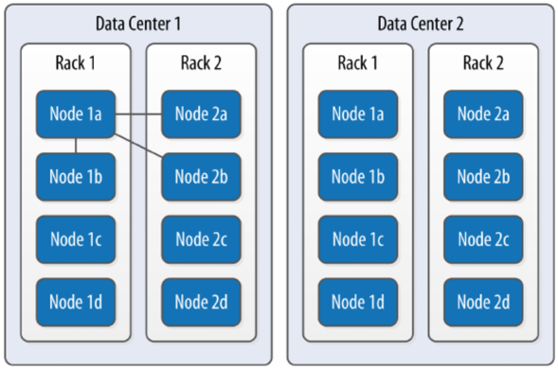
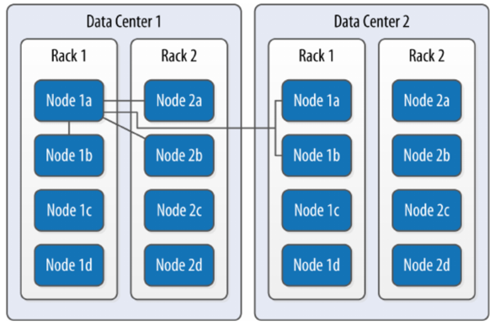
Keyspace-Level Functions
Replication 說明: * SimpleStrategy: 資料放在同 DC 不同節點中 * NetworkTopologyStrategy: 跨 DC 分散資料
# SimpleStrategy
KEYSPACE Functions | CQL
Create | CREATE KEYSPACE excelsior WITH replication = {'class': 'SimpleStrategy', 'replication_factor' : 3}; CREATE KEYSPACE excalibur WITH replication = {‘class’: ‘NetworkTopologyStrategy’, ‘DC1’ : 3, ‘DC2’ : 3}; => 指定 replication 個數 CREATE KEYSPACE excalibur WITH replication = {‘class’: ‘NetworkTopologyStrategy’, ‘replication_factor’ : 3}; => 不指定 replication 個數, auto-expanding datacenters, 如果只有兩個 datacenter, 效果會跟上面的 CQL 一樣
Show | DESCRIBE KEYSPACE excelsior;
Use | USE excelsior;
Revise | ALTER KEYSPACE excelsior WITH replication = {'class': 'SimpleStrategy', 'replication_factor' : 4};
Drop | DROP KEYSPACE excelsior;
# NetworkTopologyStrategy

Slide 4
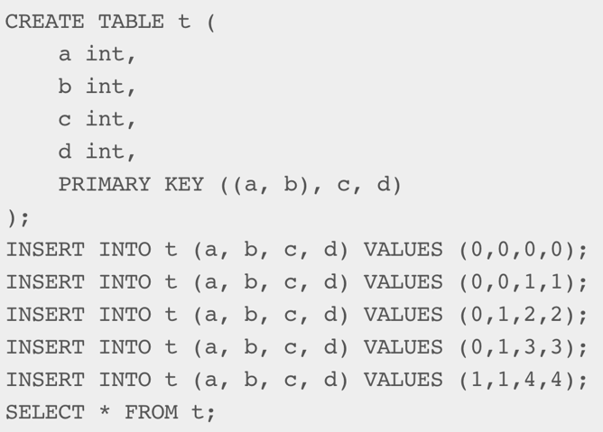
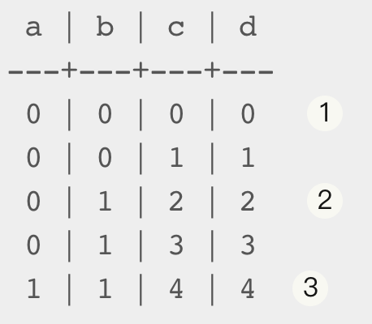
Table-Level Functions
Primary Key
PRIMARY KEY (a): “a” partition key (PK), no clustering keys (CK).
PRIMARY KEY (a, b, c): “a” is a PK, “b” and “c” is CKs.
PRIMARY KEY ((a, b), c): “a” and “b” is a composite PK, “c” is a CK.
Partition Key: Decide Partition Location
A partition: rows that share the same value for their partition key.
A hash is computed from the partition key columns and that hash value defines the partition location.
All the rows belonging to the same partition are guaranteed to be stored on the same set of replica nodes.
Clustering Key: Decide Rows’ Order for A Partition
The Keys that follow the partition key in the primary key definition.
Define the clustering order for the partition of that table. That sorting allows the very efficient retrieval of a range of rows within a partition.
Partition 1
Partition 2
Partition 3

Slide 5
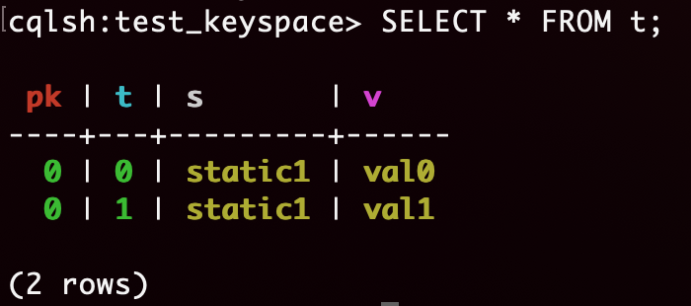
Table-Level Functions
Special “static” functions: CREATE TABLE IF NOT EXISTS t ( pk int, t int, v text, s text static, PRIMARY KEY (pk, t) ); INSERT INTO t (pk, t, v, s) VALUES (0, 0, 'val0', 'static0'); INSERT INTO t (pk, t, v, s) VALUES (0, 1, 'val1', 'static1'); SELECT * FROM t;
Result:
A column that is static will be “shared” by all the rows belonging to the same partition.
Notes:
Explanation source: bmc.com/blogs/cassandra-clustering-columns-partition-composite-key/
each table requires a unique primary key. The first field listed is the partition key, since its hashed value is used to determine the node to store the data. If those fields are wrapped in parentheses then the partition key is composite. Otherwise the first field is the partition key. Any fields listed after the partition key are called clustering columns. These store data in ascending or descending order within the partition for the fast retrieval of similar values. All the fields together are the primary key.

Slide 6
Table-Level Functions
TABLE Functions | CQL
Create | CREATE TABLE IF NOT EXISTS t ( pk int, t int, v text, s text static, PRIMARY KEY (pk, t) );
Add/Drop Table’s Columns | ALTER TABLE t ADD {column} {column_type}; ALTER TABLE t DROP {column};
Truncate | TRUNCATE TABLE t; ➔ permanently removes all existing data from the table, but without removing the table itself.
Drop | DROP TABLE IF EXISTS t; ➔ immediate, irreversible removal of the table and data.

Slide 7
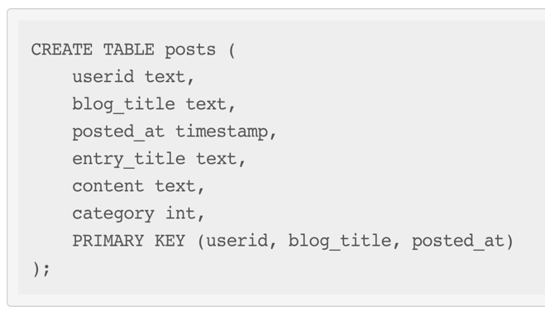
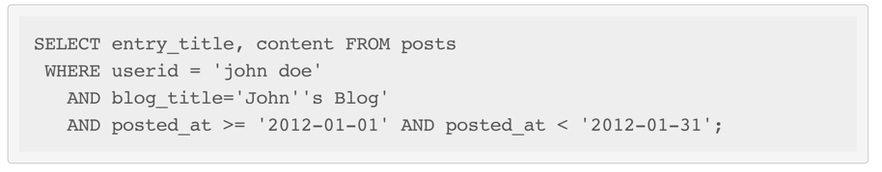
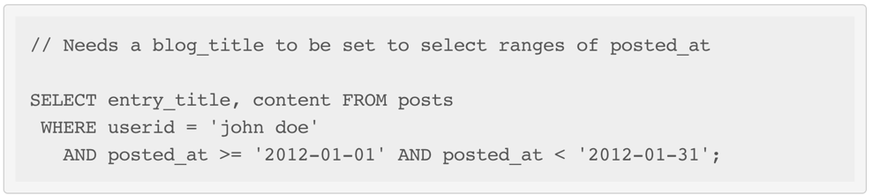
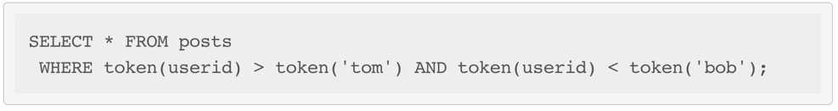
Row-Level Functions: Select
* The following query is allowed:
* But the following does not select a contiguous set of rows:
* The TOKEN function can be applied to the PARTITION KEY column to query. Rows will be selected based on the token of the PARTITION_KEY rather than on the value:
Notes:
拿同一個 node 的資料, 可以直接算 Hash => token().
TTL: specifies an optional Time To Live (in seconds) for the inserted values. If set, the inserted values are automatically removed from the database after the specified time. Note that the TTL concerns the inserted values, not the columns themselves. This means that any subsequent update of the column will also reset the TTL (to whatever TTL is specified in that update). By default, values never expire.

Slide 8
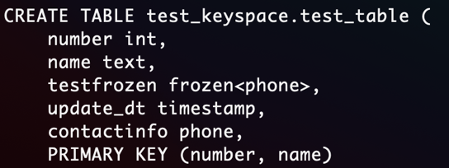
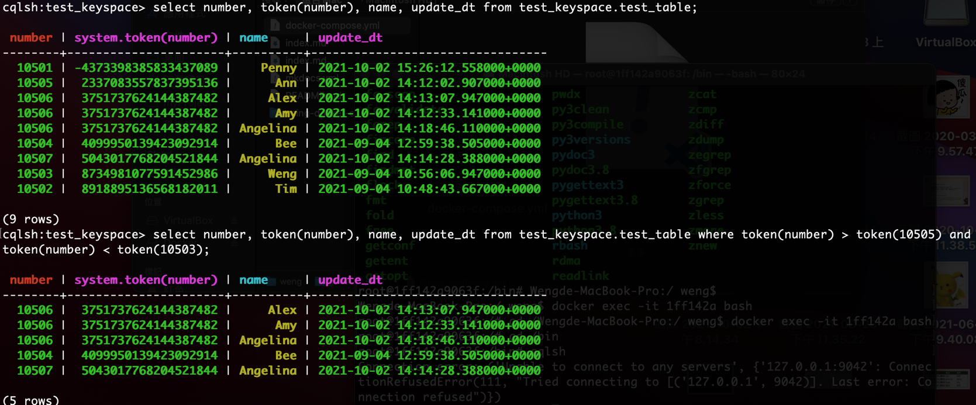
Row-Level Functions: Select
range search (partition key)

Slide 9
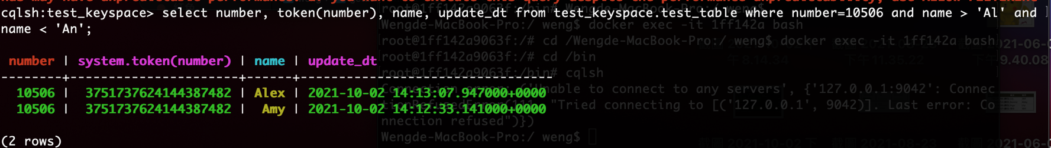
Row-Level Functions: Select
range search (clustering key)
沒有指定單一 partition search 的 error: Where 條件送 Partition Key 就好比通過 HASH 索引定位記錄，ALLOW FILTERING 就如同先做一次 TABLE SCAN，讀出大量記錄再從記錄裡過濾出符合 WHERE 條件的。 (https://www.gushiciku.cn/pl/pcjn/zh-tw)
Notes:
類比一下傳統資料庫，Where 條件送 Partition Key 就好比通過 HASH 索引定位記錄，ALLOW FILTERING 就如同先做一次 TABLE SCAN，讀出大量記錄再從記錄裡過濾出符合 WHERE 條件的。
https://www.gushiciku.cn/pl/pcjn/zh-tw

Slide 10
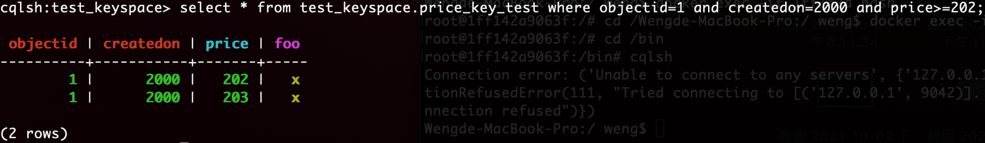
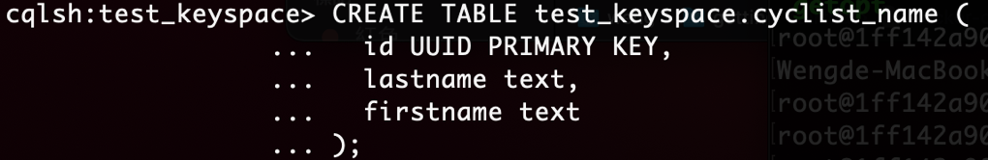
Row-Level Functions: Select
range search (other keys)
建 secondary Indexes 搜尋
SSTable Attached Secondary Indexes (SASI): improved the performance of secondary indexes
Notes:
CREATE INDEX => 不能 multi index
https://docs.datastax.com/en/dse/5.1/cql/cql/cql_using/useSASIIndex.html

Slide 11
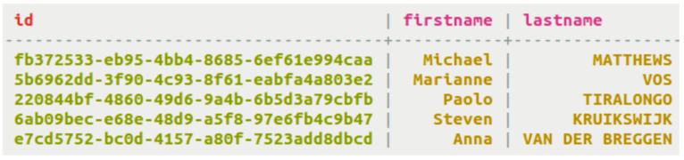
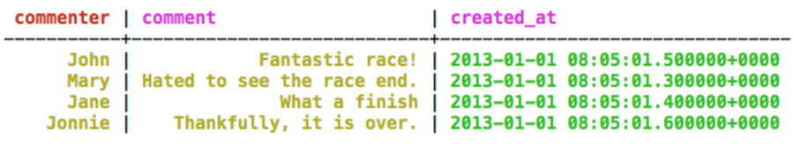
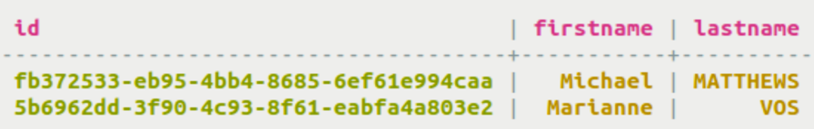
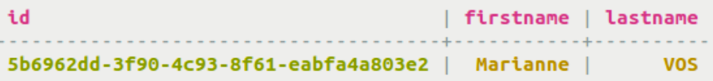
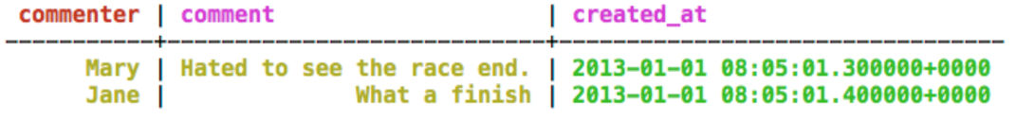
Row-Level Functions: Select
Partition Key
Ex.1
Ex.2
Index Mode | SSTable Attached Secondary Indexes (SASI) | Queried Result
PREFIX | CREATE CUSTOM INDEX fn_prefix ON cyclist_name (firstname) USING 'org.apache.cassandra.index.sasi.SASIIndex’; | SELECT * FROM cyclist_name WHERE firstname LIKE 'M%’;
CONTAINS | CREATE CUSTOM INDEX fn_contains ON cyclist_name (firstname) USING 'org.apache.cassandra.index.sasi.SASIIndex’ WITH OPTIONS = { 'mode': 'CONTAINS’ }; | SELECT * FROM cyclist_name WHERE firstname LIKE '%M%’; SELECT * FROM cyclist_name WHERE firstname > 'Mar' ALLOW FILTERING;
SPARSE | CREATE CUSTOM INDEX fn_contains ON cyclist_name (age) USING 'org.apache.cassandra.index.sasi.SASIIndex' WITH OPTIONS = { 'mode': 'SPARSE' }; | SELECT * FROM cycling.comments WHERE created_at < '2013-01-01 00:05:01.500’;
Ex.1
Ex.1
Ex.2
Notes:
https://docs.datastax.com/en/dse/5.1/cql/cql/cql_using/useSASIIndex.html

Slide 12
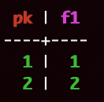
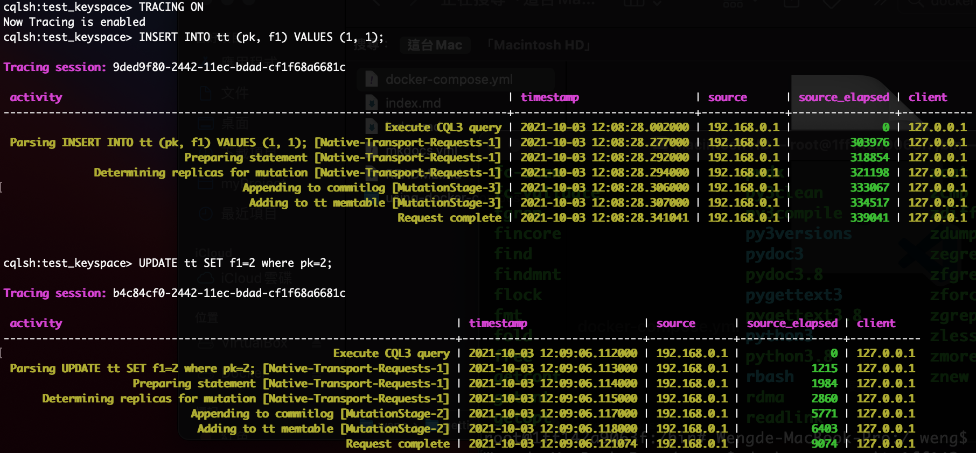
Row-Level Functions: Insert / Update
CQL 的世界通常都說 Update 可以取代 Insert.

Slide 13
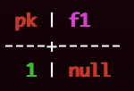
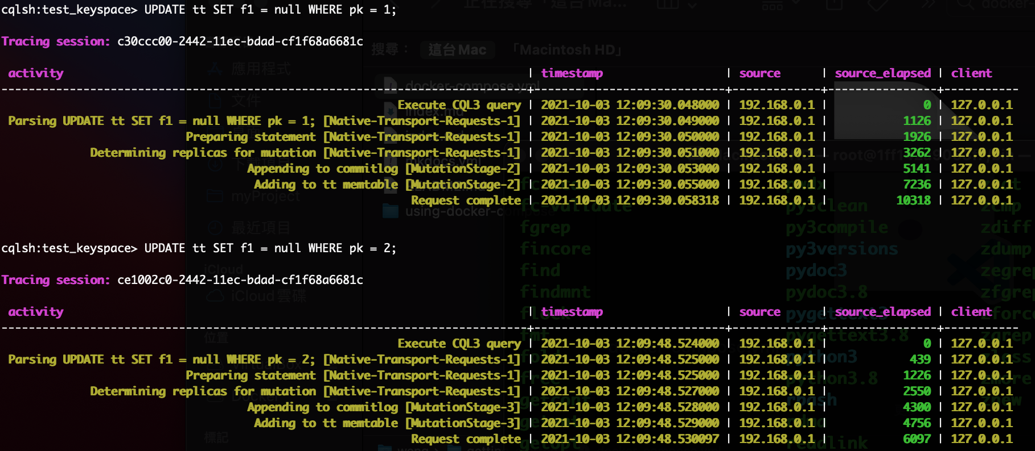
Row-Level Functions: Insert / Update
但 non-primary key 都是 null 的時候, update 的資料會消失.

Slide 14
Row-Level Functions: Insert / Update
INSERT adds a row marker, while UPDATE does not.
The row marker makes a difference for rows in which all other cells are dead: a row shows up in a query if and only if there's at least one alive cell.
an UPDATE requests that individual cells of the row be added, but not that the row itself be added. However, an "INSERT" not only adds the cells, it also requests that the row be added (this is implemented via a "row marker"). So if later all the row's individual cells are deleted, an empty row remains behind.
Notes:
https://stackoverflow.com/questions/53596513/why-does-a-upserted-row-disappear-after-updating-the-column-to-null-but-not
https://issues.apache.org/jira/browse/CASSANDRA-14478
https://issues.apache.org/jira/browse/CASSANDRA-11805
https://stackoverflow.com/questions/17348558/does-an-update-become-an-implied-insert
Scylla does the same thing.
In Scylla and Cassandra rows are sequences of cells. Each column gets a corresponding cell (or a set of cells in the case of non-frozen collections or UDTs). But there is one additional, invisible cell - the row marker (in Scylla at least; I suspect Cassandra has something similar).
The row marker makes a difference for rows in which all other cells are dead: a row shows up in a query if and only if there's at least one alive cell. Thus, if the row marker is alive, the row will show up, even if all other columns were previously set to null using e.g. updates.
inserts create a live row marker, while updates don't touch the row marker, so clearly they are different. The example above illustrates that. One could argue that row markers are "internal" to Cassandra/Scylla, but as you can see, their effects are visible. Row markers affect your life whether you like it or not, so it may be useful to remember about them.
It's sad that no documentation mentions row markers (well, I found this: https://docs.scylladb.com/architecture/sstable/sstable2/sstable-data-file/#cql-row-marker but it's in the context of explaining SSTable internals, which is probably dedicated to Scylla developers more than to users).

Slide 15
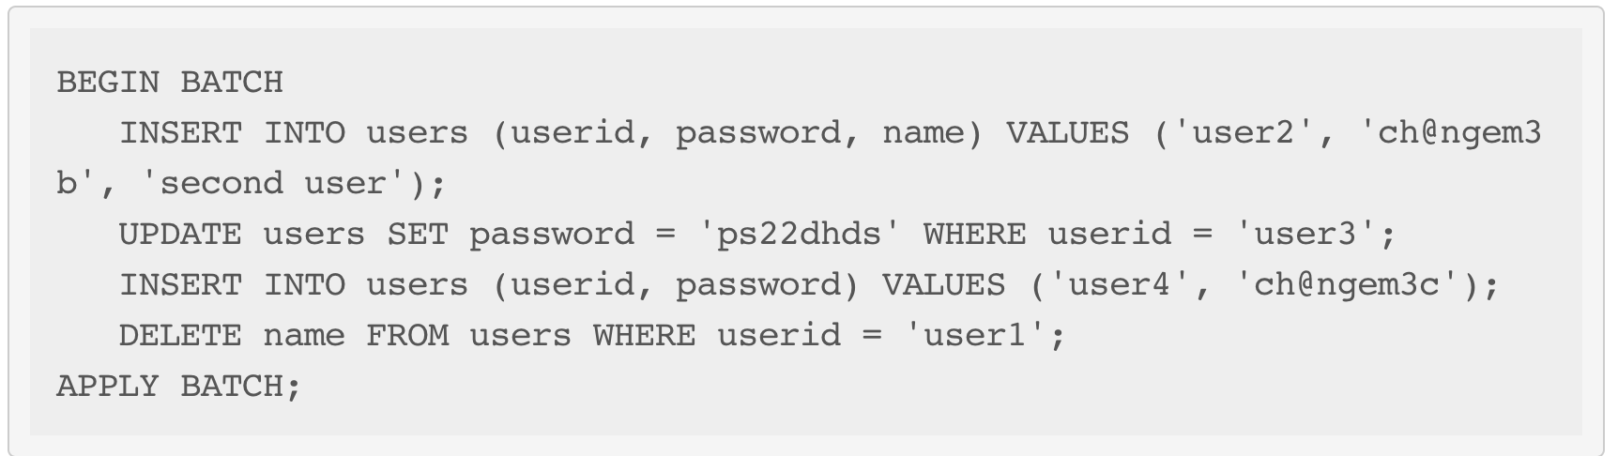
Row-Level Functions: Delete / Batch
Delete
Ex. DELETE FROM NerdMovies USING TIMESTAMP 1240003134 WHERE movie = 'Serenity';
Batch
Multiple INSERT, UPDATE and DELETE can be executed in a single statement.

Slide 16
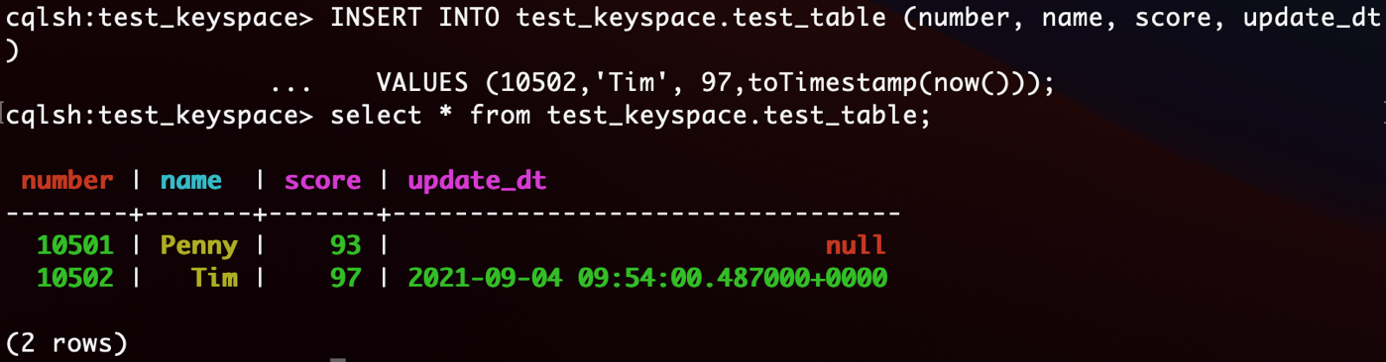
Data Types: Timestamps
Types
Timestamp: can be input in CQL either using their value as an integer, or using a string that represents an ISO 8601 date. Ex. Mar 2, 2011, at 04:05:00 AM, GMT: 1299038700000, or '2011-02-03 04:05+0000’, or '2011-02-03 04:05:00+0000’, or '2011-02-03 04:05:00.000+0000’…
Date: the format should be “yyyy-mm-dd”
CQL language: update with current time
Timestamp: toTimestamp(now())
Date: dateof(now())
Notes:
CREATE TABLE test_keyspace.test_table (
number int,
name text,
score double,
PRIMARY KEY (number, name)
);
INSERT INTO test_keyspace.test_table (number, name, score)
VALUES (10501,'Penny', 93);
ALTER TABLE test_keyspace.test_table
ADD update_dt timestamp;
INSERT INTO test_keyspace.test_table (number, name, score, update_dt)
VALUES (10502,'Tim', 97,toTimestamp(now()));
select * from test_keyspace.test_table;

Slide 17
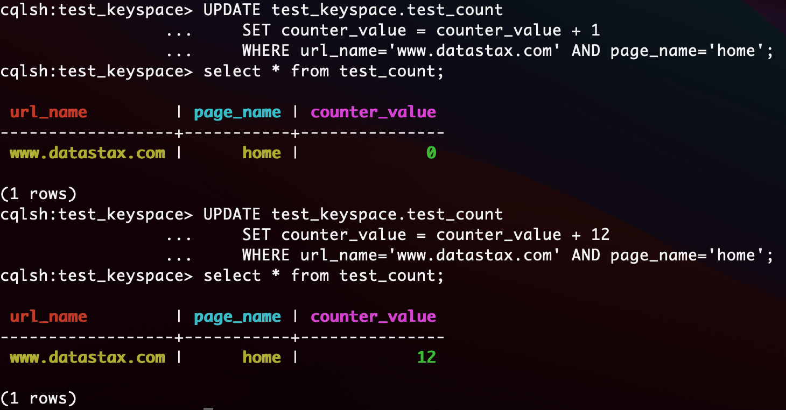
Data Types: Counters
Record the user visited websites’ number
Notes:
CREATE KEYSPACE test_keyspace WITH REPLICATION = { 'class' : 'SimpleStrategy', 'replication_factor' : 1 };
use test_keyspace ;
CREATE TABLE test_keyspace.test_count
(
counter_value counter,
url_name varchar,
page_name varchar,
PRIMARY KEY (url_name, page_name)
);
UPDATE test_keyspace.test_count
SET counter_value = counter_value + 1
WHERE url_name='www.datastax.com' AND page_name='home';
select * from test_count;
UPDATE test_keyspace.test_count
SET counter_value = counter_value + 12
WHERE url_name='www.datastax.com' AND page_name='home';
select * from test_count;

Slide 18
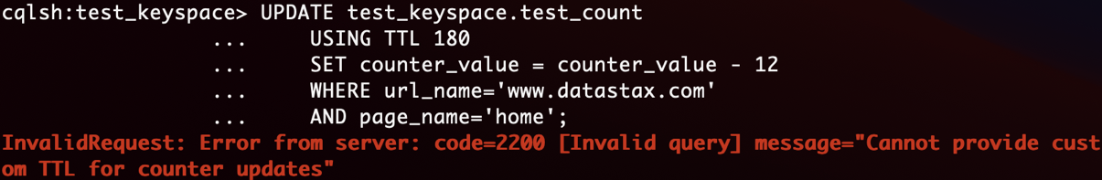
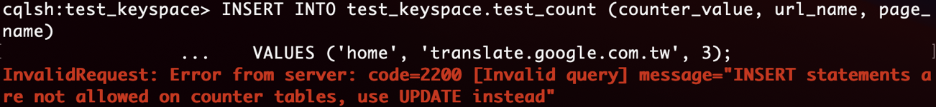
Data Types: Counters Limit
They cannot be used for columns part of the PRIMARY KEY of a table.
A table that contains a counter can only contain counters. In other words, either all the columns of a table outside the PRIMARY KEY have the counter type, or none of them have it.
非 counter 須在主鍵，所以 counter table 只能用來做計數器，基本不能做別的事
不能 set counter_value = 10，可以set counter_value = counter_value + 10
想重置計數器只能讀取計數器的值，然後加上這個值的負數值
如果遇到超時寫入失敗，重新發送請求，可能導致額外計數
Cannot use “USING TTL”
Cannot use “INSERT”

Slide 19
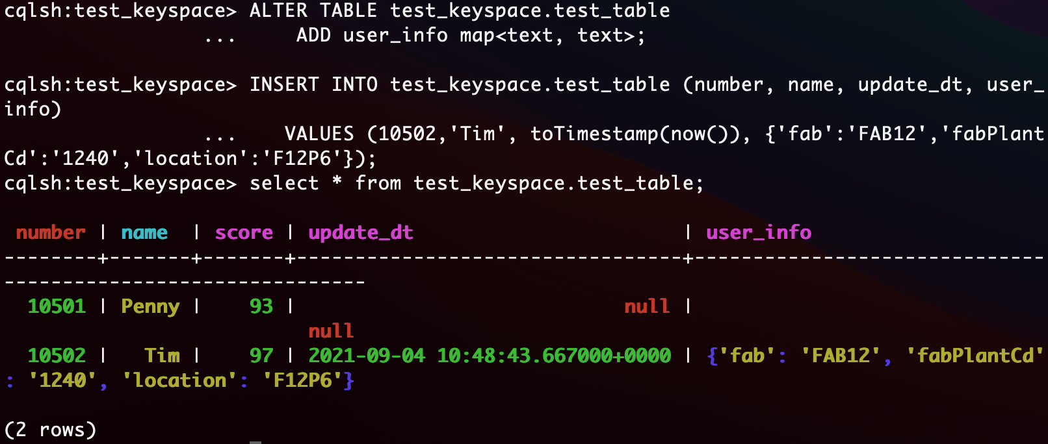
Data Types: Collections – Maps, Sets, Lists
Maps
Notes:
ALTER TABLE test_keyspace.test_table
ADD user_info map<text, text>;
INSERT INTO test_keyspace.test_table (number, name, update_dt, user_info)
VALUES (10502,'Tim', toTimestamp(now()), {'fab':'FAB12','fabPlantCd':'1240','location':'F12P6'});
select * from test_keyspace.test_table;

Slide 20
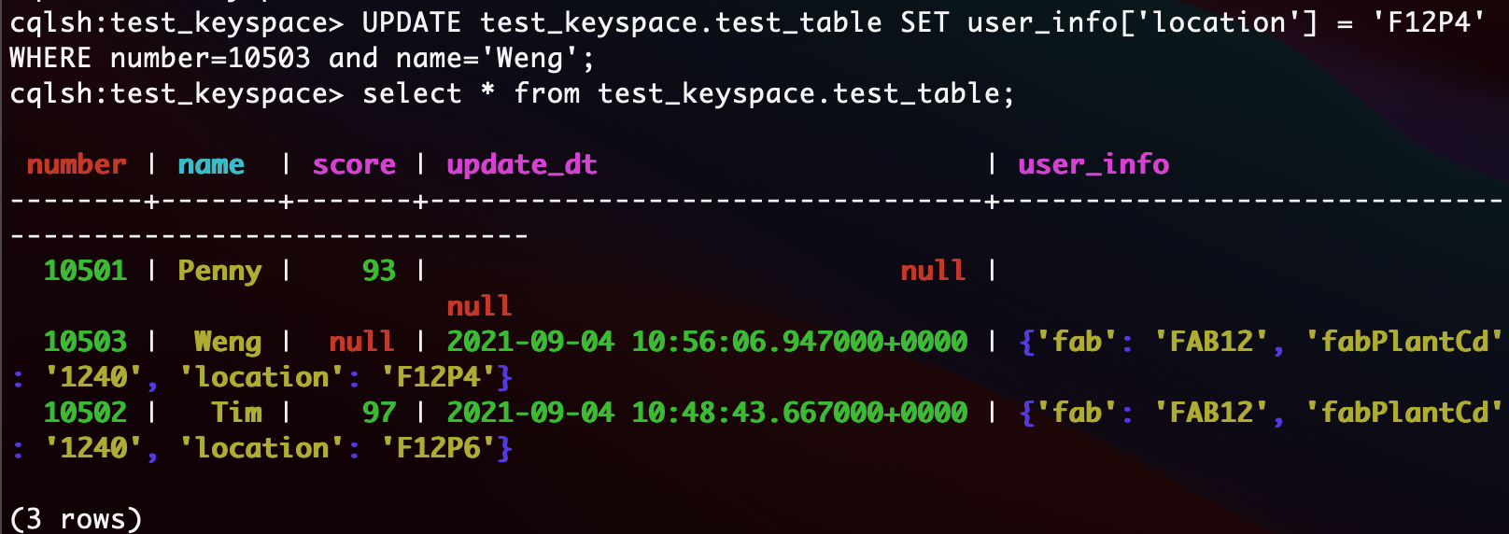
Data Types: Collections – Maps, Sets, Lists
Maps: By key update
Notes:
UPDATE test_keyspace.test_table SET user_info['location'] = 'F12P4' WHERE number=10503 and name='Weng';
select * from test_keyspace.test_table;

Slide 21
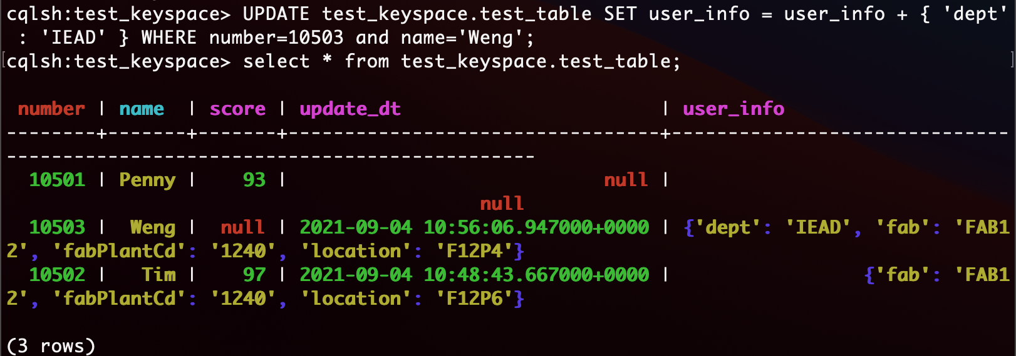
Data Types: Collections – Maps, Sets, Lists
Maps: Add or delete key-value pairs by “+” or “-”.
Notes:
UPDATE test_keyspace.test_table SET user_info = user_info + { 'dept' : 'IEAD' } WHERE number=10503 and name='Weng';
select * from test_keyspace.test_table;

Slide 22
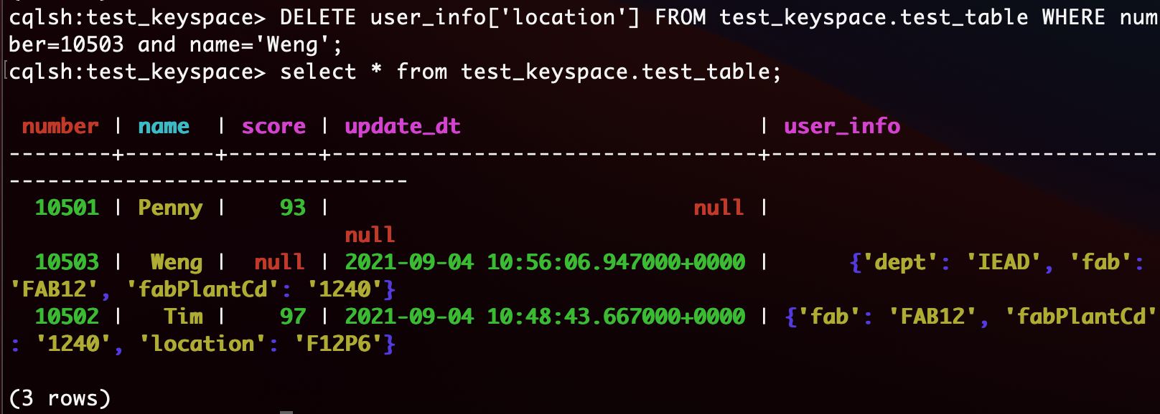
Data Types: Collections – Maps, Sets, Lists
Maps: Another delete key-value pairs’ way

Slide 23
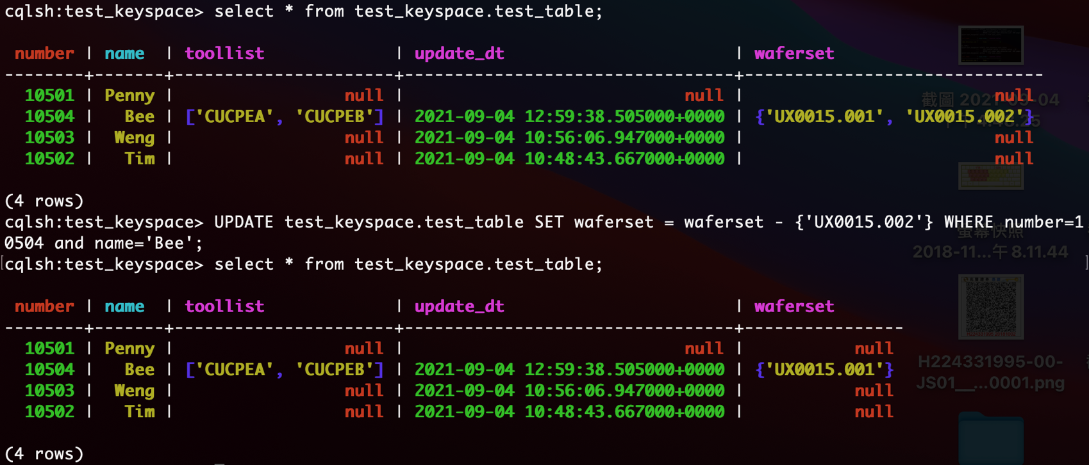
Data Types: Collections – Maps, Sets, Lists
Sets: Add or delete key-value pairs by “+” or “-”.
Notes:
UPDATE test_keyspace.test_table SET waferset = waferset - {'UX0015.002'} WHERE number=10504 and name='Bee';
select * from test_keyspace.test_table;

Slide 24
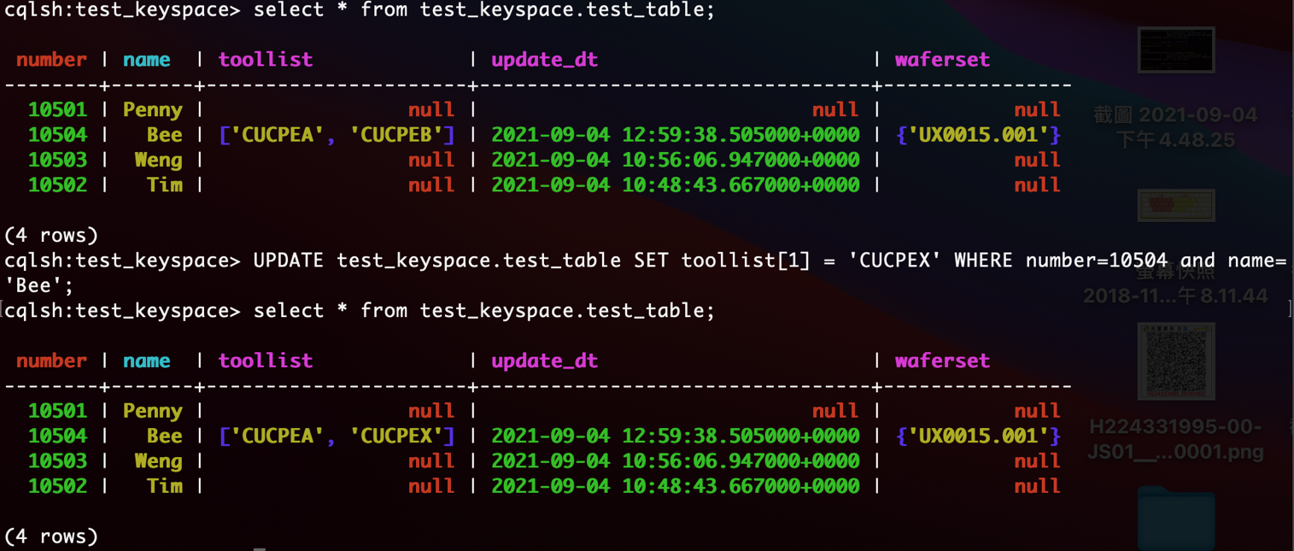
Data Types: Collections – Maps, Sets, Lists
Lists: 比起全部一起 update, 用 position 的方式 update performance 會比較不好.
Setting and removing an element by position and removing occurences of particular values incur an internal read-before-write. These operations will run slowly and use more resources than usual updates (with the exclusion of conditional write that have their own cost).

Slide 25
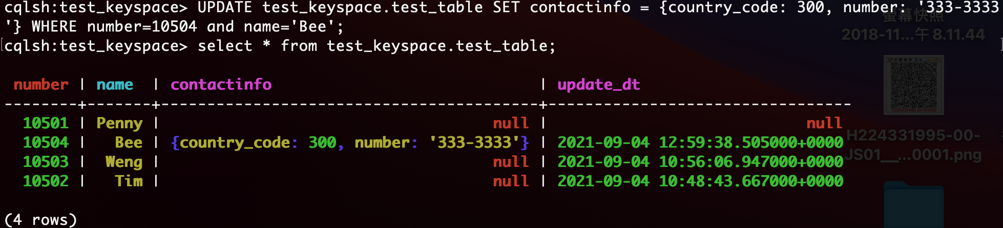
Data Types: UDT (User-Defined Types)
CREATE TYPE phone (country_code int, number text);
ALTER TABLE test_keyspace.test_table ADD contactinfo phone;
UPDATE test_keyspace.test_table SET contactinfo = {country_code: 300, number: '333-3333'} WHERE number=10504 and name='Bee’;
Do not add quote “”, add quote will be read by Map type
Notes:
CREATE TYPE phone (country_code int, number text);
ALTER TABLE test_keyspace.test_table ADD contactinfo phone;
select * from test_keyspace.test_table;
UPDATE test_keyspace.test_table SET contactinfo = {country_code: 300, number: '333-3333'} WHERE number=10504 and name='Bee’;
select * from test_keyspace.test_table;

Slide 26
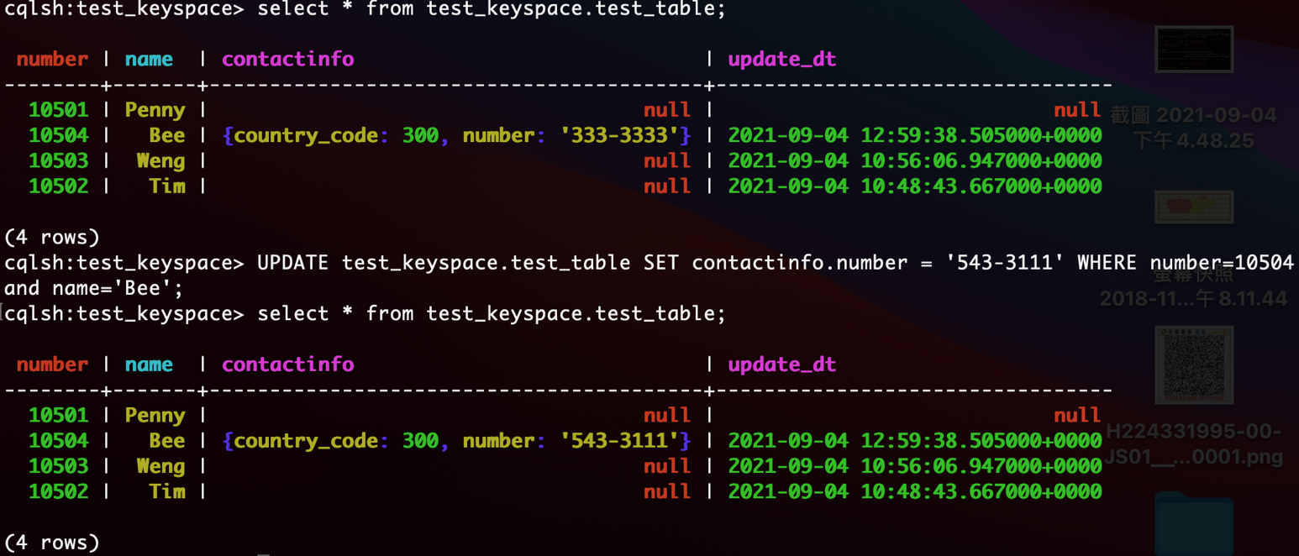
Data Types: UDT (User-Defined Types)
UPDATE test_keyspace.test_table SET contactinfo = {country_code: 300, number: '333-3333'} WHERE number=10504 and name='Bee';

Slide 27
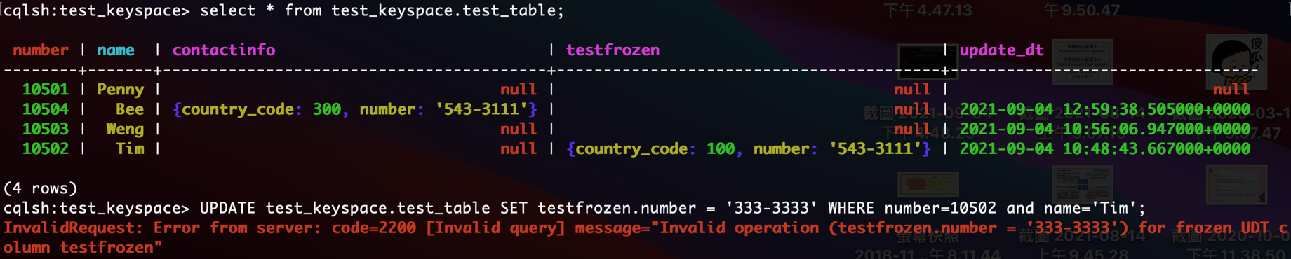
Data Types: UDT (User-Defined Types)
Frozen 說明: A frozen value serializes multiple components into a single value. Non-frozen types allow updates to individual fields. Apache Cassandra™ treats the value of a frozen type as a blob. The entire value must be overwritten.
ALTER TABLE test_keyspace.test_table ADD testfrozen frozen<phone>;
UPDATE test_keyspace.test_table SET testfrozen = {country_code: 100, number: '543-3111'} WHERE number=10502 and name='Tim';
Frozen Error => UPDATE test_keyspace.test_table SET testfrozen.number = '333-3333' WHERE number=10502 and name='Tim';
Notes:
ALTER TABLE test_keyspace.test_table ADD testfrozen frozen<phone>;
select * from test_keyspace.test_table;
UPDATE test_keyspace.test_table SET testfrozen = {country_code: 100, number: '543-3111'} WHERE number=10502 and name='Tim';
select * from test_keyspace.test_table;
// Frozen Error
UPDATE test_keyspace.test_table SET testfrozen.number = '333-3333' WHERE number=10502 and name='Tim';

Slide 28
Reference
Cassandra document: https://cassandra.apache.org/doc/latest/cassandra/cql/index.html
https://www.gushiciku.cn/pl/pcjn/zh-tw
https://stackoverflow.com/questions/53596513/why-does-a-upserted-row-disappear-after-updating-the-column-to-null-but-not
https://issues.apache.org/jira/browse/CASSANDRA-14478
https://issues.apache.org/jira/browse/CASSANDRA-11805
https://stackoverflow.com/questions/17348558/does-an-update-become-an-implied-insert
Counter: https://www.cnblogs.com/didda/p/4789013.html
Duration: https://docs.datastax.com/en/dse/5.1/cql/cql/cql_reference/upsertDates.html
UDT: https://stackoverflow.com/questions/42532743/cassandra-frozen-keyword-meaning
SimpleStrategy vs NetworkTopologyStrategy: http://cooperbear2.blogspot.com/2018/08/cassandra-6-consistency-levels-and.html

Slide 29
BackUp

Slide 30
Cassandra 資料寫入機制
Cassandra 的修改都是寫入。前面提到 Cassandra 速度快，快在不需要定位資料。任何 Update 命令，在傳統資料庫上，都需要把這條記錄讀到記憶體裡，並上鎖。而在 Cassandra 上，Update 命令會變成一條 INSERT 語句，那豈不是在系統裡重 KEY 了嗎？這裡便要依靠記錄上的 Timestamps。
Cassandra 的每次查詢，都會把所有重的 KEY 讀出來，但是永遠會以最新的 Timestamps 為準。這就解決了把所有的修改，都變成寫入的問題。但是，這麼幹有兩大顯而易見問題。第一，資料會無限的膨脹，吃掉磁碟。第二，資料膨脹會帶來查詢需要讀出的重複資料增加，無限的膨脹則會無限的增加，讀取效能就會受損。
所以這裡，就要介紹壓縮（Compaction）的概念。這裡要特別的注意，這不是我們通常說的資料庫壓縮技術，那個通常用的 Compress。只是由於多個官方文件都把 Compaction 翻譯成了壓縮，我個人覺得它更應該翻譯成資料的整理。Compaction 是在資料庫後臺非同步做的，接著前面的內容，它的內容至少有比如把墓碑資料真實移除，把時間戳比較老的資料移除，重新整理 SSTable 的儲存檔案等。
https://www.gushiciku.cn/pl/pcjn/zh-tw

Slide 31
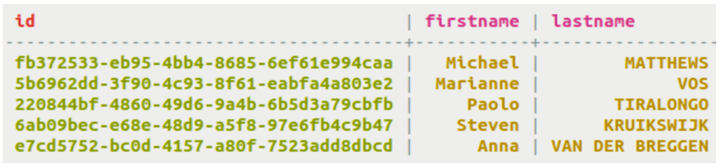
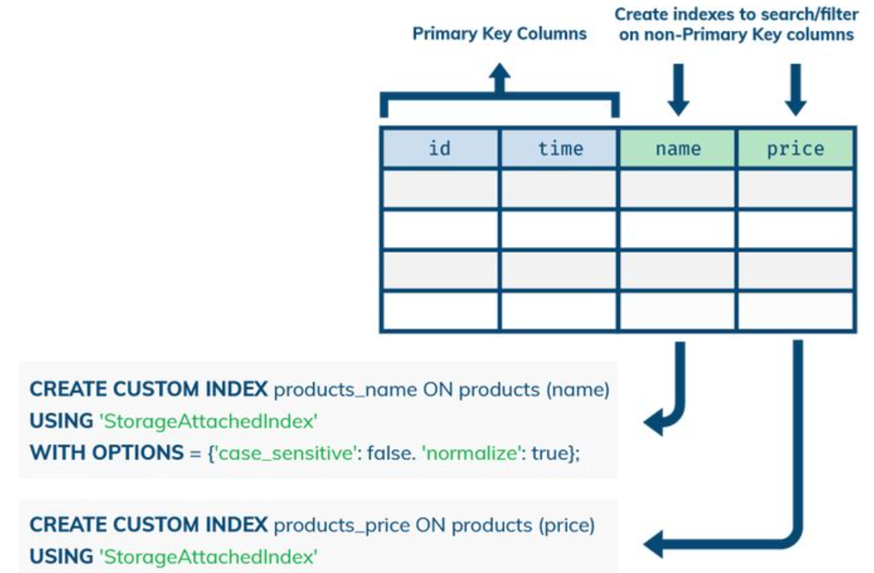
Row-Level Functions: Select
SSTable Attached Secondary Indexes (SASI)
PREFIX index (Default Mode)
CREATE CUSTOM INDEX fn_prefix ON cyclist_name (firstname) USING 'org.apache.cassandra.index.sasi.SASIIndex’;
SELECT * FROM cyclist_name WHERE firstname LIKE 'M%’;
CONTAINS index
CREATE CUSTOM INDEX fn_contains ON cyclist_name (firstname) USING 'org.apache.cassandra.index.sasi.SASIIndex’ WITH OPTIONS = { 'mode': 'CONTAINS’ };
SELECT * FROM cyclist_name WHERE firstname LIKE '%M%’;
SELECT * FROM cyclist_name WHERE firstname > 'Mar' ALLOW FILTERING;
Notes:
https://docs.datastax.com/en/dse/5.1/cql/cql/cql_using/useSASIIndex.html

Slide 32

Row-Level Functions: Select
Partition Key
SSTable Attached Secondary Indexes (SASI)
SPARSE index
The SPARSE index is meant to improve performance of querying large, dense number ranges like timestamps for data inserted every millisecond. If the data is numeric, millions of columns values with a small number of partition keys characterize the data, and range queries will be performed against the index, then SPARSE is the best choice.
By sparse, it means that for each indexed value, there are very few (maximum 5 actually) matching rows. If there are more than 5 matching rows, an exception similar to the one below will be thrown: java.io.IOException: Term - ‘xxx’ belongs to more than 5 keys in SPARSE mode, which is not allowed. ➔. index 對到的 rows count > 5 會報異常
CREATE CUSTOM INDEX fn_contains ON cyclist_name (age) USING 'org.apache.cassandra.index.sasi.SASIIndex' WITH OPTIONS = { 'mode': 'SPARSE' };
SELECT * FROM cycling.comments WHERE created_at < '2013-01-01 00:05:01.500';
Notes:
https://docs.datastax.com/en/dse/5.1/cql/cql/cql_using/useSASIIndex.html

Slide 33
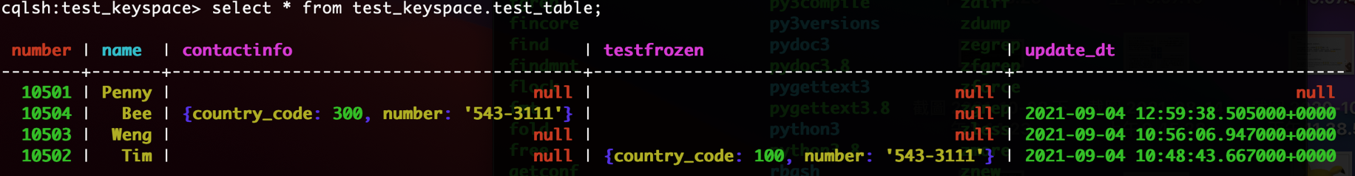
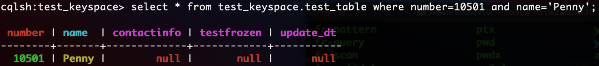
Select / Insert / Update / Delete / Batch Functions
Select
Best performance

Slide 34
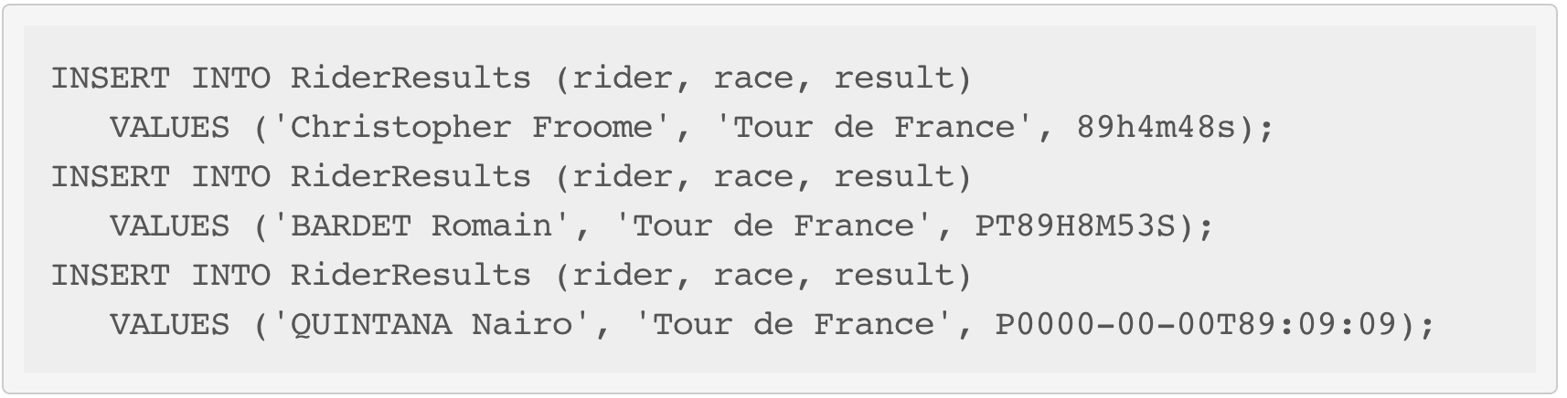
Data Types: Duration
Example
Duration columns cannot be used in a table’s PRIMARY KEY. This limitation is due to the fact that durations cannot be ordered. It is effectively not possible to know if 1mo is greater than 29d without a date context.

